Slide 1
Practice Test Answers
ODDS

Slide 6
Notes:
Switch atomic mass and atomic number

Slide 9
Transition metals not carbon family
Notes:
Tranistion metals

Slide 10
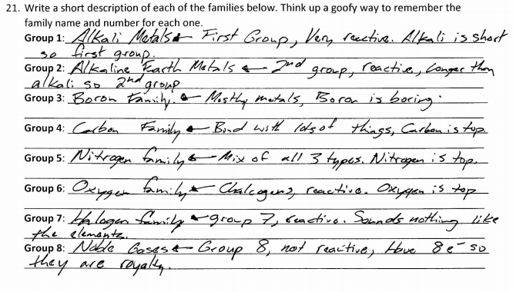

Slide 11
End of Odds

Slide 12
Practice Exam Answers
EVENS

Slide 16
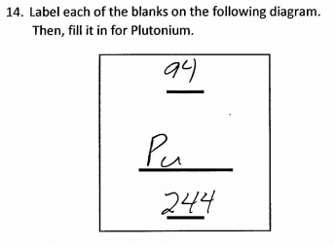

Slide 18
Titanium not germanium
Notes:
Change to titanium

Slide 20
End of Evens

Slide 21
Exit Ticket
“Before tomorrow’s exam, I need to study _____________________.”
“I think I will do great on _______________________ tomorrow.”
“I _______________ need to complete the study guide before tomorrow.”

